Slide 1
Video Game Analysis & Technical Design
  Ch.12 IP & Marketing

Slide 2
What is Intellectual Property?
The most important branch of law for video game developers and publishers to understand
IP affects:
  Employee Contracts
  Employment Agreements
  Every License in the Game Industry

Slide 3
What is Intellectual Property?
Many game are made from works in other media through exchange of IP:
  Film
  Literature
  History

Slide 4
Why is IP Important for a Game Company?
Laws are in place to protect IP holders and their creative work
  Laws protect designers from:
    Developers that take work without compensating
    Publishers that sell work without compensating
    Competitors that steal confidential information without compensating

Slide 5
What is Intellectual Property?
When buying a game, what does someone buy?
  Manual
  Box Art
  Game Art
  Music
  Story
  World
  Graphics Engine
All are purchased IP

Slide 6
What is Intellectual Property?
IP protection law can fall under the following categories:
  Copyright
  Trade Secret
  Trademark
  Patent

Slide 7
Copyright
The exclusive right to reproduce or sell an author’s original work
In legal term, copyright law allows the owner to prevent the reproduction of his work

Slide 8
Copyright
International Copyright Laws originate from the US constitution
Categories eligible for copyright protection are:
  Literary works
  Musical works, including accompanying words
  Dramatic works, including accompanying music
  Choreographic works
  Pictorial, graphic and sculpture works
  Motion picture and other Audiovisual works
  Sound recordings
  Architectural works
Video game protection added later during the 1980s.

Slide 9
Copyright
Copyright can be placed on video game:
  Music
  Story
  Characters
  Art
  Box Design
  Web Site Design

Slide 10
Copyright
Copyright is often misunderstood
  Copyright is not the protection of ideas
    i.e. Video Game Idea, Video Game Pitch
  Copyright is protection of expression
    i.e. GDD, Code, Saved Art File

Slide 11
Copyright
Process
  Copyright can be registered from the Canadian Intellectual Property Office
    http://strategis.ic.gc.ca/sc_mrksv/cipo/cp/cp_main-e.html
  Applications must be completed online or mailed
  A 60 day review process will commence to certify the copyright
  Costs are approximately $65.00

Slide 12
Copyright
Duration of Copyright Protection
  Copyright ends at a legally defined point in time
    Set out in rules in the Copyright Act.
    One general rule and many special rules that apply to certain kinds of works
    The general rule is that copyright lasts for:
      The life of the author
      The remainder of the calendar year in which the author dies
      50 years following the end of the calendar year
      i.e. Therefore, protection will expire on December 31 of the 50th year
  After that, the work becomes part of the public domain and anyone can use it

Slide 13
Copyright
Copyright Infringement
  Cease and Desist
  Penalties
    Willful Copyright Infringement
      Up to $150,000 per work infringement
      Imprisonment

Slide 14
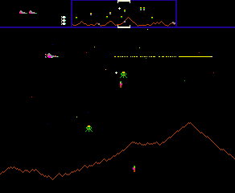
Copyright Case Study: Defender
Midway filed a lawsuit against Sony Ericson
Sony Ericson was using the game on mobile phone without permission
Midway requested:
  Court Award Damages
  Reimbursement of Legal Fees
  Turn Over of Mobile Phones
  Software

Slide 15
Copyright Case Study: Razor 1911
Sean Michael Breen
  Leader of warez group Razor 1911
  Illegally distributing games over the Internet
  4 years imprisonment and $700,000 fine

Slide 16
Copyright Case Study: Yonatan Cohen
Yonatan Cohen
  Created a video game console
  Illegally sold un-licensed Nintendo game
  5 years imprisonment, hundreds of thousands of dollars in cash and deportment to Israel

Slide 17
Copyright
Derivative Work
  Composite work of pre-existing copyrighted works
  Doom – the Video Game to Doom – the Movie
  Shrek – the Movie to Shrek – the Video Game
  The Lord of the Rings
    J.R.R. Tolkien series of books
    Peter Jackson Movies
    EA Video Games
      Battle for Middle Earth

Slide 18
Copyright
Exceptions to copyright
  Fair Dealing (Canada), Fair Use (US)
  Fair Dealing
    Section 29 of the Canadian Copyright Act
    Allows any copying of all works for personal/research use regardless of license!
    Canadians can legally download and use music/movies/software/games for personal use only (no sharing)
  Huge pressure on Canada to change this from the U.S.

Slide 19
Copyright
Public Domain
  Before 1923
    Public Domain
    Free to Use
  1923 – March 1989
    Depends on work published with copyright registration
    Depends on copyright registration renewal
  After March 1989
    Under copyright for 50 (Canadian) – 70 (US) years death of author

Slide 20
Copyright
Public Domain or Not?
  Mythica (Microsoft never published) and Dark Age of Camelot
    Based on Norse mythology and Muspellheim
  Star Wars
  Battlefield 1942 and Medal of Honor

Slide 21
Trade Secrets
Proprietary business information that is kept secret within the company
Information, including a formula, pattern, compilation, program device, method, technique, or process that:
  Derives independent economic value
  Is subject of efforts that are reasonable under circumstances to maintain secrecy

Slide 22
Trade Secrets
Company must restructure in order to preserve
Video game companies may use Non-Disclosure Agreements

Slide 23
Trade Secret Case Study: Coca Cola
The Coca Cola formula is the best kept trade secret
Over 100 years preserved
No informal descriptions have been verified

Slide 24
Trade Secrets
Video Game Trade Secrets:
  MMO Subscription List
  Development Tools

Slide 25
Trade Secrets
Process
  No registration fee
Duration of Trade Secret
  As long as the owner prevents information from becoming common knowledge

Slide 26
Trade Secrets
Trade Secret Infringement
  The Uniform Trade Secret Act protects damages for misappropriation
    Damages measured with loss of profit
    Damages measured from the profit gained from the misappropriation
    Damages measured by royalty payment

Slide 27





Trademarks

Slide 28
Trademarks
A symbol that distinguishes one business entity’s product over the products of others
Can be
  Words
  Names
  Symbols
  Graphics
  Short Phrases

Slide 29
Trademarks
Process
  Trademark can be registered from the Canadian Intellectual Property Office
    http://strategis.ic.gc.ca/sc_mrksv/cipo/tm/tm_main-e.html
    Applications must be completed online or mailed
  Up to a 1 year review process will commence to certify the trade mark
  Costs are approximately $250 - $300
  ™ indicates the mark is being used for a business
  ® indicates the mark is successfully registered

Slide 30
Trademarks
Duration of Trademark Protection
  Immortal
  Some trademark symbols have been used for over 100 years
Trademark Infringement
  Similar to Copyright

Slide 31
Trademarks
Trademarks are divided into five categories
  Fanciful
    No meaning
    Strong marks companies associate with them
    i.e. XBOX
  Arbitrary
    Words
    No associated with products
    e.g. Apple

Slide 32
Trademarks
Trademarks are divided into five categories
  Suggestive
    Natural words that suggest, but do not describe a product
    e.g. Electronic Arts
  Descriptive
    Require extensive marketing
    e.g. Futureshop
  Generic
    Never converted into a trademark
    e.g. Half Life 2

Slide 33
Patents
A federal grant for the exclusive right to make, use, or sell a novel, useful, and non-obvious invention for a specific period

Slide 34
Patents
Patents grant the right to an invention
  For video games:
    Hardware
    Software techniques and engines
    Types of game interactions that have not been used in the past

Slide 35
Patents
Process
  Patents can be registered from the Canadian Intellectual Property Office
    http://strategis.ic.gc.ca/sc_mrksv/cipo/patents/pt_main-e.html
    Applications must be completed online or mailed
  Application processing is very lengthy
  Costs vary between $10,000 - $30,000
    Additional $2000 for filing

Slide 36
Patents
Duration of Patents Protection
  Unlimited
Protection Infringement
  Up to $1,000,000 in damage fees

Slide 37
Licensing IP
Typically stipulated in employment/development agreements
  Publishers are considered licensors
  Developers are considered licensees
If work is created from an employee at work as an activity
  Work is considered “work made for hire”
  Company retains copyright

Slide 38
Licensing IP
Copyright Agreements among Parties
Right | Developer | Publisher | Distributor | End User
Reproduce | Yes – For Development Use | Yes | Yes – Distribution Terms | No
Distribute | No | Yes | Yes – Limited to Geographic Territory | No
Import | No | Yes | Yes – From Publisher | Yes – Authorized Distributor
Export | Yes – For Developer/Publisher Offices in other countries | Yes | Yes – Limited to Geographic Territory | No
Publically Perform | No | No | No | No
Create Derivative Work | Yes – For Ports or Sequels | No – For Developer Use | No | No

Slide 39
Elements of a License
Field of Use
  Restricts the way a license is used
  Could be in the form of distribution
    Limited to Retailers
  Restricts the right to backup

Slide 40
Elements of a License
Duration
  Finite duration for license should be specified
  Expiry Terms must be outlined

Slide 41
Elements of a License
Geographic
  Limited license by geographic scope

Slide 42
Elements of a License
Warranty & Indemnity
  Warranty – A promise made by a seller to a buyer that the item or service being sold will have certain standard characteristics
  Indemnity – Holding a third party responsible for the reimbursement of all loss or damage incurred by an injured party

Slide 43
Elements of a License
Sub-Licensing
  Same or similar IP rights to a third party

Slide 44
Elements of a License
Cross-Licensing
  Limiting licensing based on party
    Publisher has distribution rights
    Game development company has technology rights

Slide 45
IP Litigation
Violations of the owner’s right to exclude from real property are considered trespass
A court order to cease the infringement is called an injunction
If the infringement is persistent, courts may award damages

Slide 46
IP Litigation
Litigation Procedures
  Pre-Filing Requirements
  Declaration of Judgment Action
  Notice
    Complaint
  Trial Schedule
  Preliminary Injunction
  Summary Injunction
  Discovery
    Intentional Disclosures
    Interrogation
    Deposition
  Trial
  Judgement
  Damages Awarded

Slide 47
Traditional Marketing
Game development may have taken years
Audience needs to be prepared
Production team creates the game
Marketing team promotes the game

Slide 48
Traditional Marketing
Large game companies
  Internal marketing department
Small game companies
  Work with independent marketing companies

Slide 49
Traditional Marketing
Attract as many customers as possible
Involved from the game’s first pitch
  Provide feedback
  Marketing analysis
  Test competitor’s products

Slide 50
Traditional Marketing
Product manager
  Creates and manages marketing strategies
  Oversees promotional material
  Creates presentations for tradeshows
  Works on packaging
  Sets up focus groups

Slide 51
Traditional Marketing
The lead-up to product ship
  Marketing may start early
  Normally starts about halfway through production
    Schedule is set
    Release date is scheduled
  Games have a limited shelf life

Slide 52
Traditional Marketing
Mid-November to mid-January
  50% – 90% of computer games sold
  Heavy competition for shelf space

Slide 53
Traditional Marketing
Overselling
  Showing off the product too early
  Promising too much
  Competitor may release a similar game
  Watch out for Vaporware
    Product that is promoted but never ships

Slide 54
Traditional Marketing
Underselling
  Not enough promotion
  Publisher lost interest
  Does not impress the industry
  Too many similar products
  Target platform may lose its appeal

Slide 55
Traditional Marketing
Large projects might cost $3 – $4 million
  Develop purchase print ads
  Promotional demos
  Marketing Development Funds (MDF)
Small projects (e.g. mobile games) are limited and more risky
  Use cheap targeted methods of advertisement (e.g. Facebook)
  Low cost / free version to promote

Slide 56
Traditional Marketing
End-cap display
  Special display at the end of a tier of shelves
Unique selling points (USP)
  “fun compelling game play”
  “from the people who brought you…”

Slide 57
Traditional Marketing
Press releases
  Short document about a product
  Exciting headline
  Released to the media
  May be sent out several times during production
  Cheap

Slide 58
Traditional Marketing
Sell sheet
  Similar to press releases
  Aimed at distributors and retailers
  Slick paper
  More expensive than press releases

Slide 59

Traditional Marketing
Sell sheet

Slide 60
Traditional Marketing
Trade shows
  Electronic Entertainment Exposition (E3)
  European Computer Trade Show (ECTS)
  Tokyo Game Show

Slide 61
Traditional Marketing
Promotional stints
  Development team
    On-line chats
    Television shows
    Local conventions
    Game tournaments
    Gaming nights at colleges/universities

Slide 62
Traditional Marketing
Product placement
  Game appears in a different medium
    Movie
    Television show
  Non-game products in games
    Actual car models

Slide 63
Traditional Marketing
Advertisements
  Expensive
  Print ads in game industry magazines
  Pop-up ads on Internet gaming sites
  In-store displays
  Television ads

Slide 64
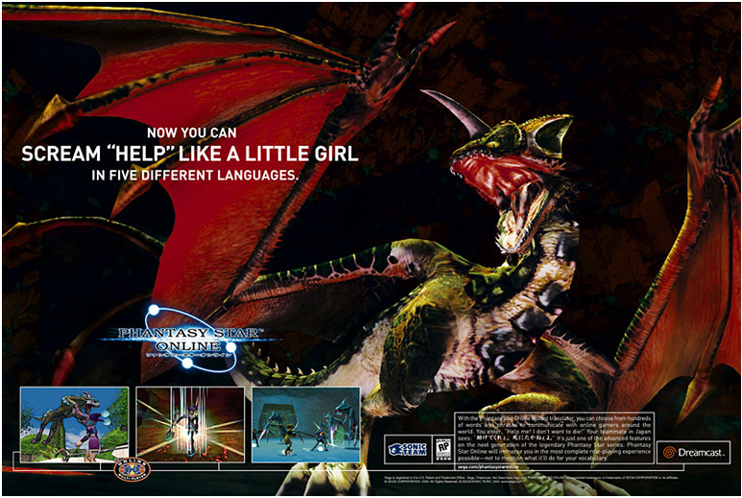
Traditional Marketing
Magazine ads
  Computer Games
  Computer Gaming World
  Electronic Gaming Monthly
  Nintendo Power
Magazine ads
  Long lead time
  Heavy competition during Christmas season
Circulation
  Number of readers of a magazine
Cost-per-thousand (CPM)
  Advertising rates are based on this
Remnant space
  Unused pages sold at a discounted rate

Slide 65
Traditional Marketing
Banner
  Graphic image on a web page
Interstitial
  Pop-up ads
Floating ads
  Combination of banner and pop-up ads
Pay-per-view
  Fee based on number of users that visit the site
Cost-per-click
  Fee based on how often the ad is clicked
Cost-per-action
  Based on the user performing a certain activity
Cost-per-lead
  Based on how many customers provide information

Slide 66
Traditional Marketing
Game packaging
  Designed by marketing
  Feedback card
  Registration form
  Manual
Package designer
  Creates a dummy package
  Product prepared for printer

Slide 67
Traditional Marketing
Strategic Marketing Plan
  Promote new products
  Support existing products
  When will new games appear
  What resources will be available

Slide 68
Marketing Analysis
Research
  Evaluating competitive products
  Collecting market research data
  Collating feedback data
  Marketing analysis for game proposals
Sell-in
  Number of copies delivered to retailers
Sell-through
  Number of copies that are actually sold
Focus groups
  Small group of people who play the game
  Interviewed
  Might fill out a questionnaire
    Is the game fun
    Are the controls easy to use

Slide 69
Using Social Media and MORE to
Market Your Games
The goal of marketing your game it to get noticed by your target audience and then get them excited about your game.
  Social media is the easiest and most effective way that can be used to do both of these things, but you have to plan your approach wisely to hit the largest number of potential users and build street cred.

Slide 70
Using Social Media and MORE to
Market Your Games
  #1 Design a cool website for your game
    Every upcoming game must have a single place to go that contains the information about your game. Put a TON of energy into every part of this site – you want people to think “Wow – I’ve got to play this game when it comes out” after seeing your site.
  #2 Create social media pages for your game Facebook, Twitter, etc.
    And make sure that you have people actively posting and sharing new and cool things from those pages! Plenty of pics are crucial.

Slide 71
Using Social Media and MORE to
Market Your Games
  #3 Create giveaways that have your site on them Coaster, buttons, stickers.
    Whatever works. Make it interesting by adding competition to the mix – for example, add a line that says “Like us on Facebook for a chance to win a ___.” Put pics of the giveaways on your social media pages.

Slide 72
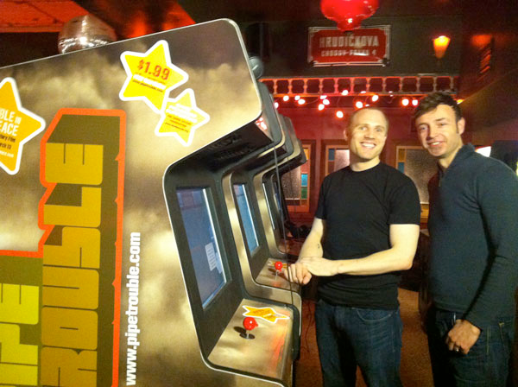
Using Social Media and MORE to
Market Your Games
  #4 Attend lots of events
    Attend every possible event that caters to your target audience for at least 6 months prior to the game release to build up momentum. Bring giveaways as well as a novelty to these events, such as an early version of your game to play on an iPad. Or, just like the guys who made Pipe Trouble, put a sample of your game in a real arcade cabinet and take it to different events and key locations:

Slide 73
Using Social Media and MORE to
Market Your Games
  #5 Leverage every bit of press and recognition that you get
    Did CKCO TV do a quick spot on your display at a particular event? Make sure that pics and comments are tweeted and posted to every social media site and web page you own, as well as other forums and sites too!
And above all……make sure every post you make and event you attend gives people the impression that you are excited about the game and that they should be too.

Slide 74
Using Social Media and MORE to
Market Your Games
  There is nothing worse than seeing a game being demoed at some event by two guys who clearly don’t want to be there and act as if they are defending feature decisions in their game.
  If you demo a game at an event, listen to your audience, and if there is something they don’t like about your game, say something along the lines of “Well, we’ll just have to put that in there and make it cool before release then, eh?” and ask them if they’d be interested in playtesting the new feature.

Slide 75
Using Social Media and MORE to
Market Your Games
  What do you think the chances are that the person will tell everyone they know about the game and how cool it was that the game developers are putting in a feature that they wanted? It’s the little things like this that get you the best media exposure in the end. Thank you social media.

